Slide 1
Welcome to the Association
An in depth look at NBA rookies and there statistical contribution to their team
Zechariah Avello, Cohort DA12

Slide 2
Presentation Overview
1 | Statistical Background in the NBA
2 | Does a rookie’s individual efficiency (PER) correlate to their contribution of winning?
3 | Breakdown an NBA’s team Scouting Department and how well they draft.
4 | Does a more efficient rookie have a substantially different shot selection than the least efficient?
5 | What can be concluded?

Slide 3
Statistical Background
Player Efficiency Rating (PER)
*PER = 0.68 + 26.77(FG) – 35.58(FGA) + 26.32(FT) – 25.47(FTA) +
42.74(OR) + 11.45(DR) + 29.7(AST) + 47.3 (STL) +
38(BLK) – 47.9(TO) – 18.8(PF) + 41.1(PTS)
Win Shares (WS): Estimated number of wins contributed by the player
Box Plus/Minus (BPM): Box score estimate of points per 100 possessions normalized against the average player
Value Over Replacement Player (VORP): A metric for a players worth compared to a replacement level player.
* Winston, W. L. (2009). Mathletics: how gamblers, managers, and sports enthusiasts use mathematics in baseball, basketball, and football. Princeton, Princeton University Press.

Slide 4
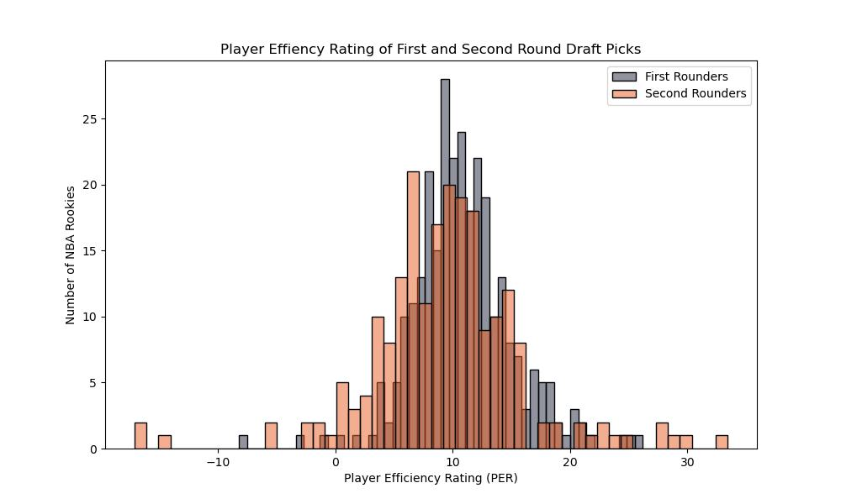
Who’s Data Are We Looking At?
NBA rookies who have been drafted in the last ten years (2014-2023)
An NBA Draft consist of two rounds of thirty picks, sixty in total
All statistics come from the rookie year of the athlete

Slide 5
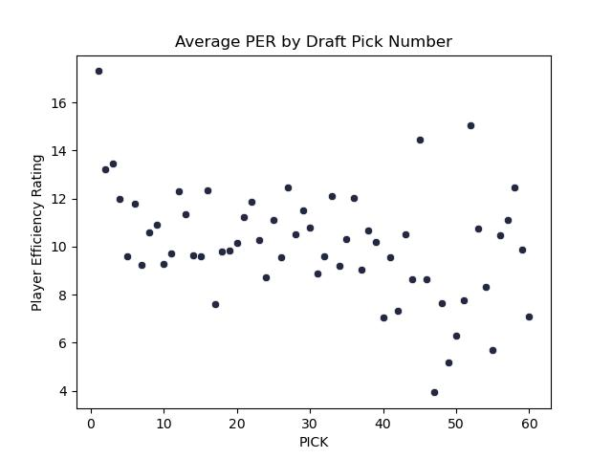
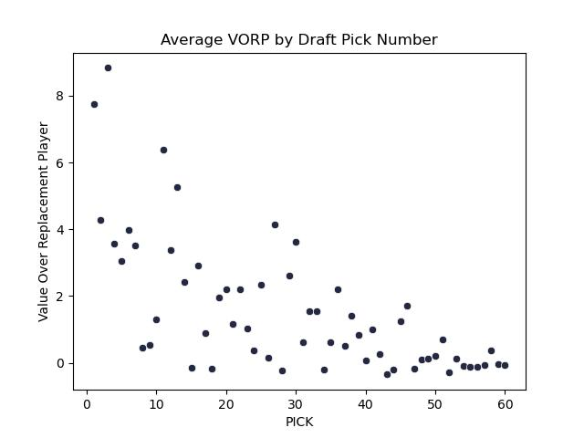
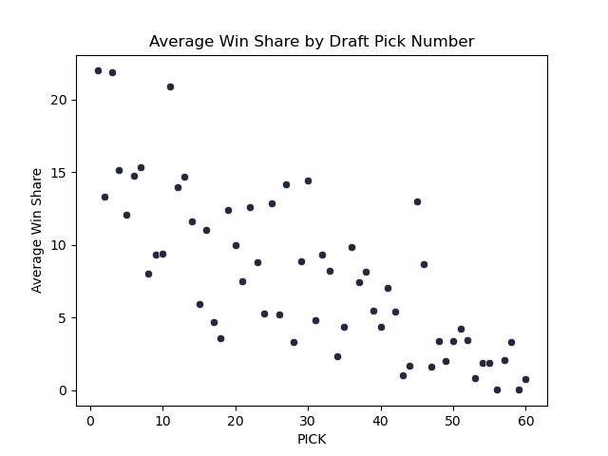
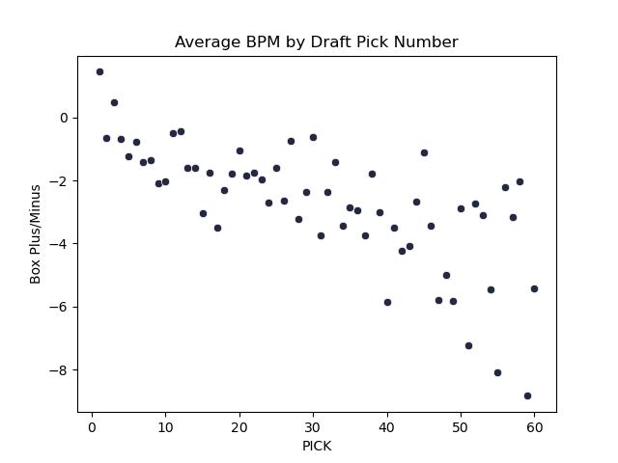
Metric Evaluation of Draft Pick
Statistical Metric | Correlation to Draft Pick
PER | -0.392
VORP | -0.665
Win Share | -0.768
BPM | -0.711

Slide 6
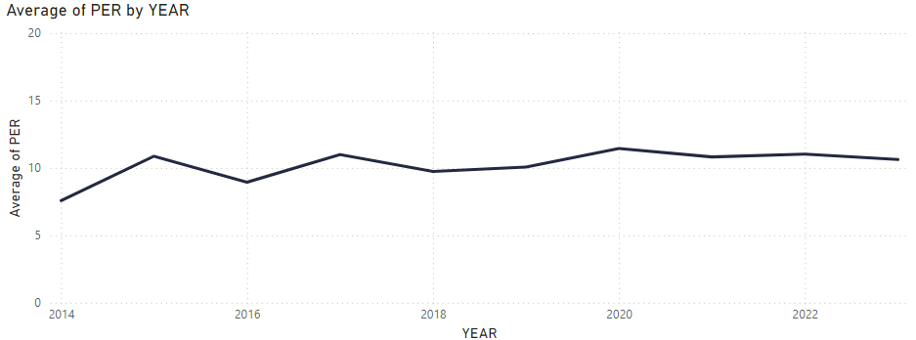
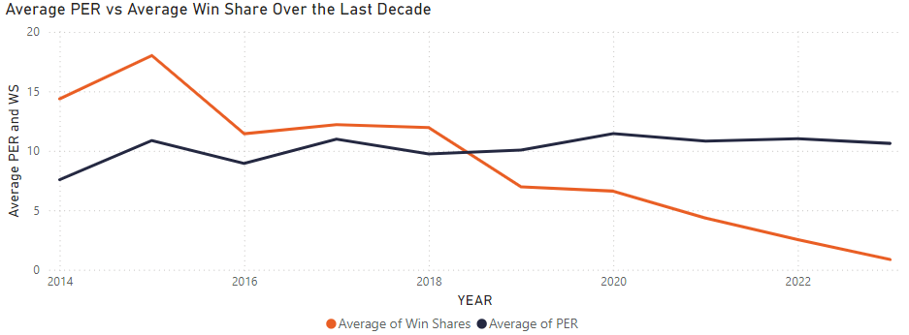
Does Efficiency Lead to Winning?

Slide 7
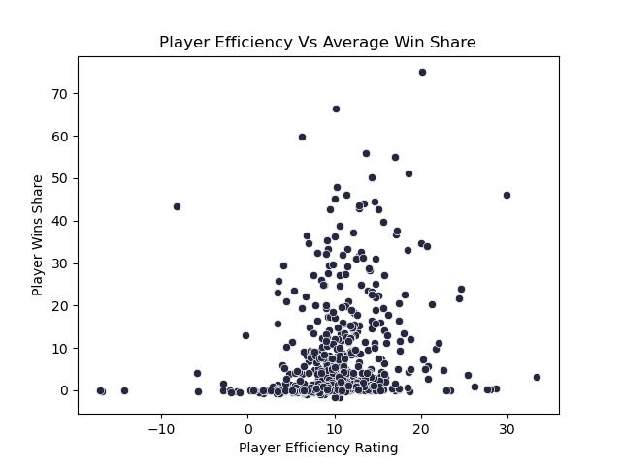
Does Efficiency Lead to Winning?
The assumption is a players efficiency correlates to win share
Very weak correlation
Most rookies attribute to 0 wins
So, what advanced stats correlate with each other?
Correlation = 0.230

Slide 8
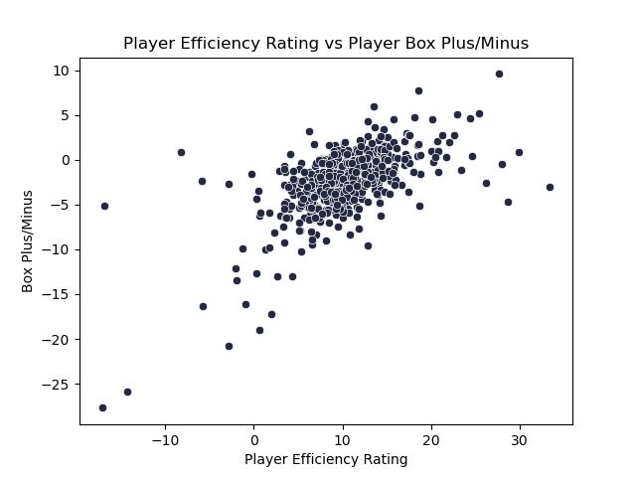
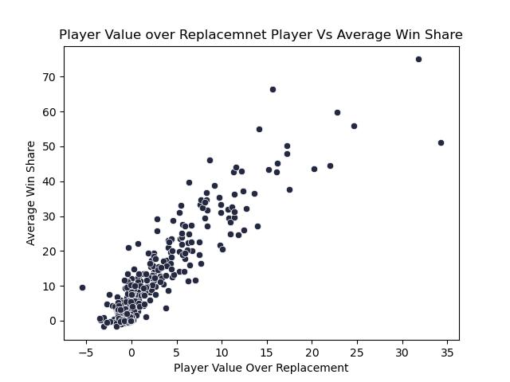
So Which Stats Correlate?
Correlation = 0.610
Correlation = 0.904

Slide 9
Breaking Down How Teams Draft
Which teams are consistently drafting for immediate help?
Which team whiffs on their draft selections?
What team trends do we see based on how well they draft?
Performance evaluation of the scouting department

Slide 10
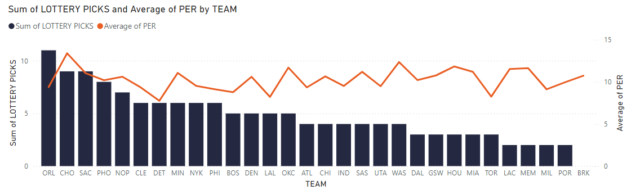
Analyzing Team’s Scouting Department
Average Player Efficiency Rating for Each Team

Slide 11
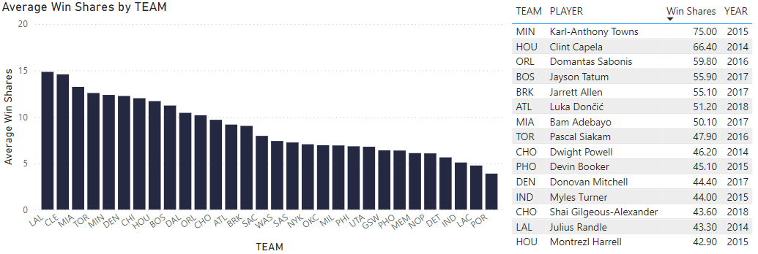
Analyzing Team’s Scouting Department
Average Win Shares for Each Team

Slide 12
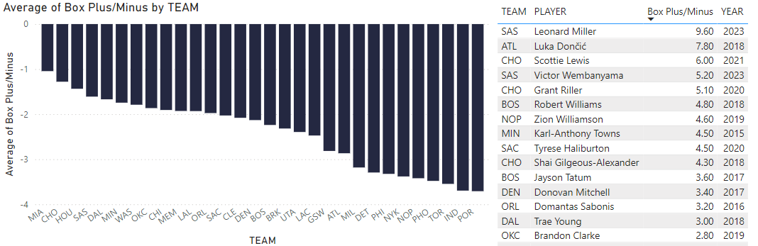
Analyzing Team’s Scouting Department
Average Box Plus/Minus for Each Team

Slide 13
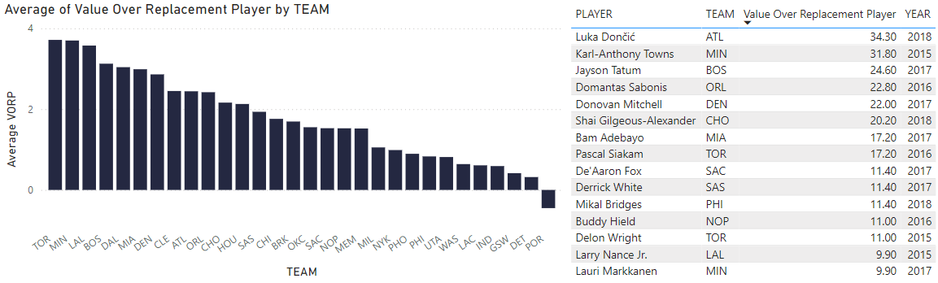
Analyzing Team’s Scouting Department
Value Over Replacement for Each Team

Slide 14






Analyzing Team’s Scouting Department
Who Was Consistently in the Top 5 and Bottom 5?
Top Scouting Performance |  | Bottom Scouting Performance
Miami Heat | 0 NBA Titles 3 Conference Titles 6 Division Titles | Portland Trail Blazers | 0 NBA Titles 0 Conference Titles 2 Division Titles
Charlotte Hornets | 0 NBA Titles 0 Conference Titles 0 Division Titles | Detroit Pistons | 0 NBA Titles 0 Conference Titles 0 Division Titles
Houston Rockets | 0 NBA Titles 0 Conference Titles 4 Division Titles | Indiana Pacers | 0 NBA Titles 0 Conference Titles 2 Division Titles

Slide 15
Shot Selection Difference
What is the difference between the most efficient rookies and least efficient?
Using the 2023 NBA draft class, we are looking at…
The criteria for eligibility is the athlete must have played at least 20 games and average over 10 minutes a game
Three Most Efficient | Three Least Efficient
Victor Wembanyama (PER = 25.4) | Rayan Rupert (PER = 6.2)
Trayce Jackson-Davis (PER = 22.6) | Julian Strawther (PER = 7.7)
Dereck Lively II (PER = 18.8) | Anthony Black (PER = 8.2)

Slide 16
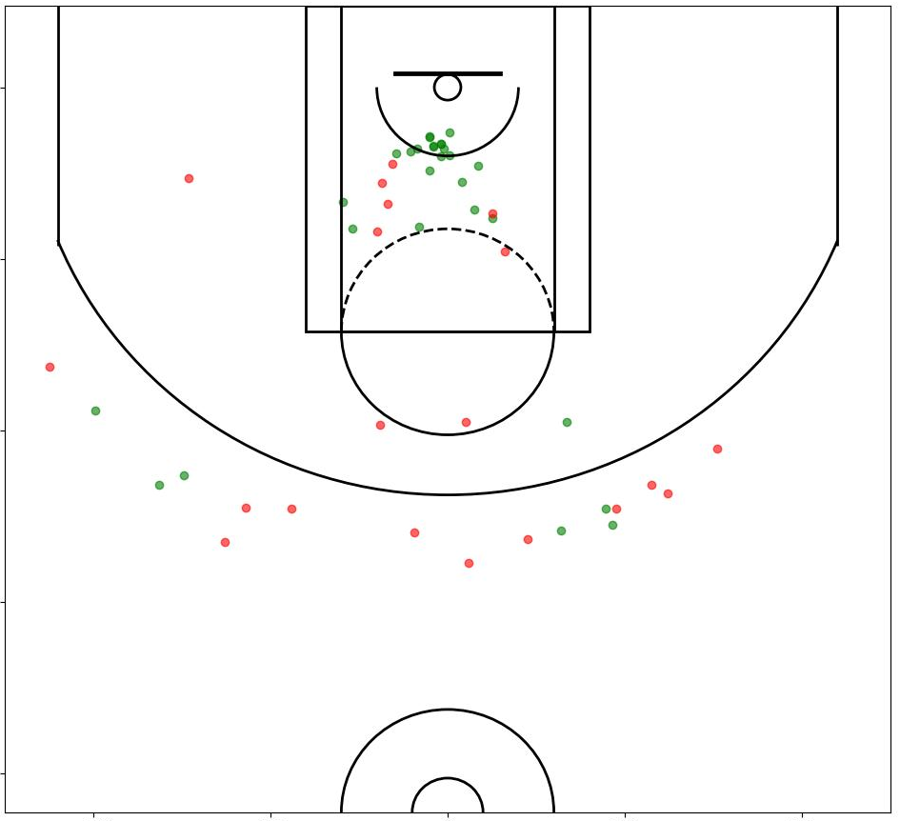
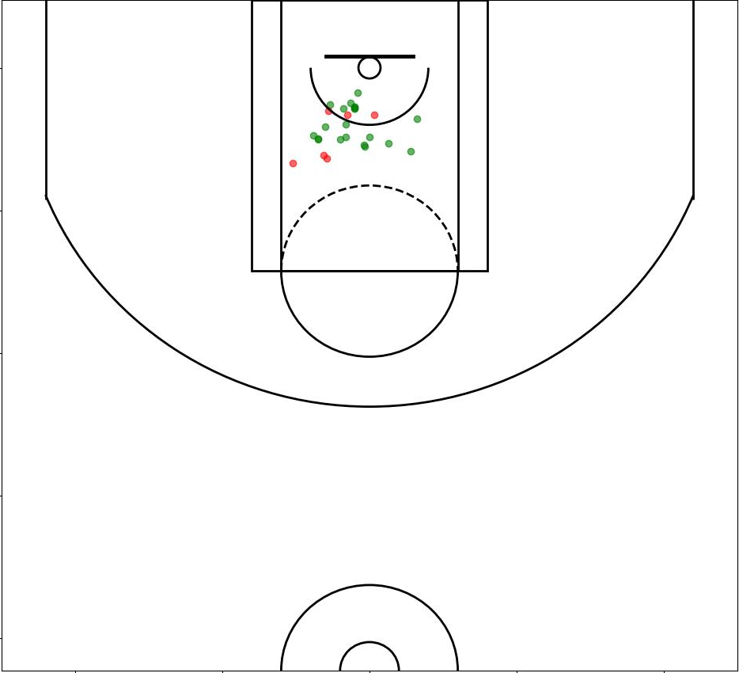
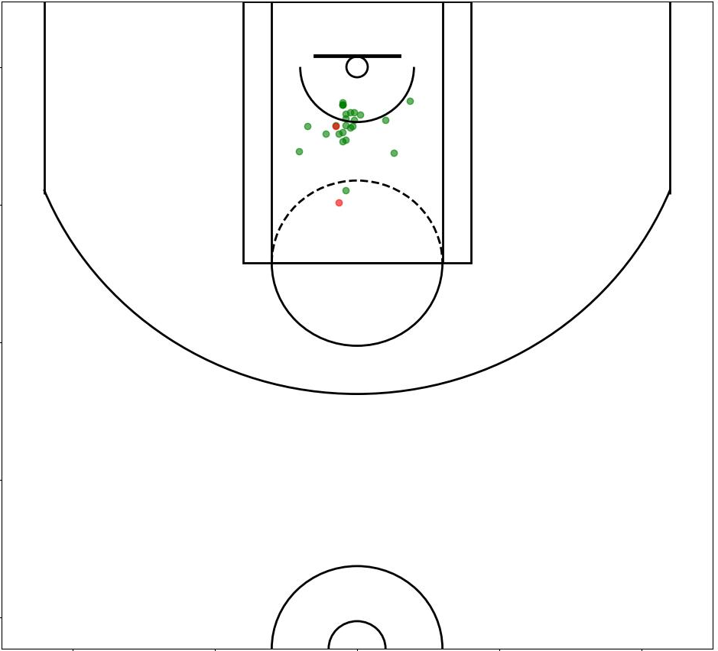
Most Efficient Rookies
Victor Wembamyama | Trayce Jackson-Davis | Dereck Lively II

Slide 17
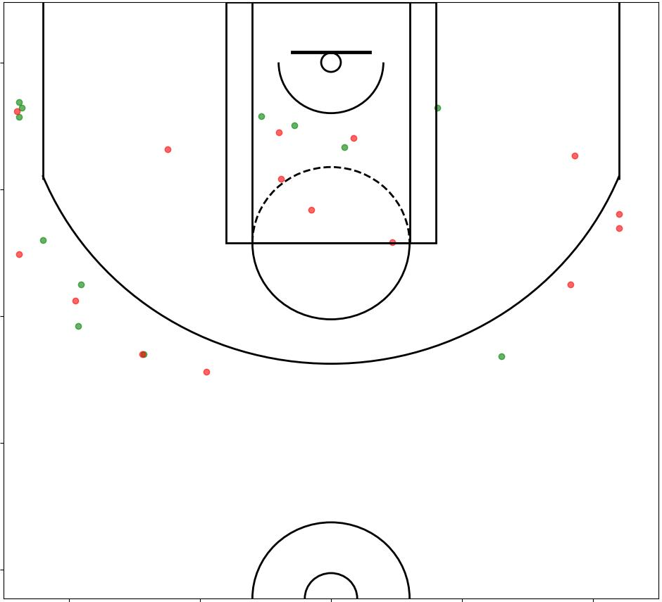
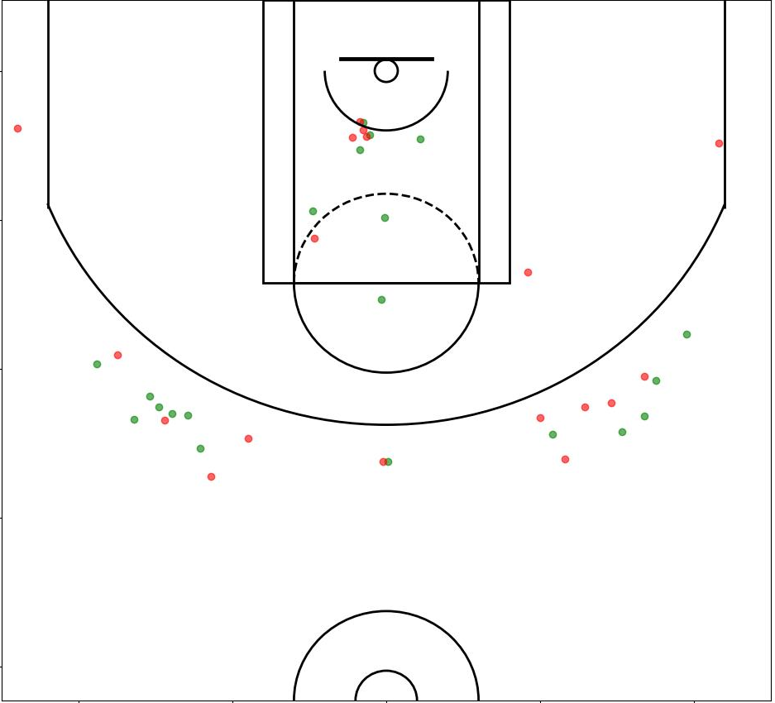
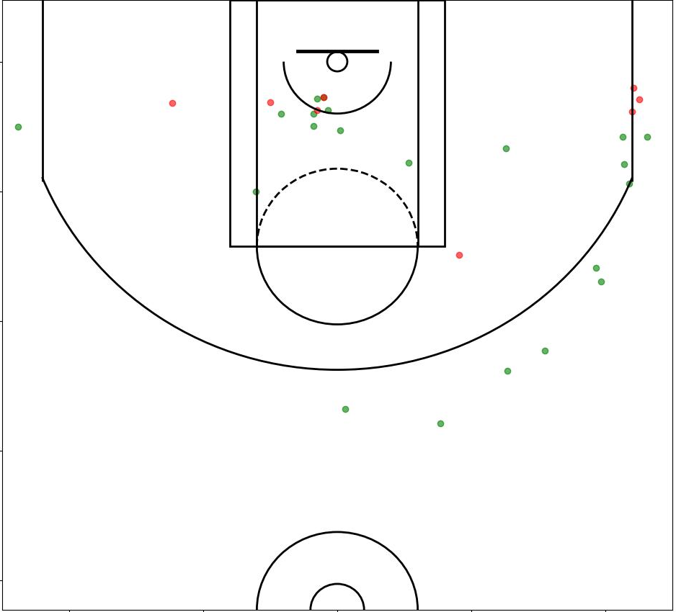
Least Efficient Rookies
Rayan Rupert | Julian Strawther | Anthony Black

Slide 18
Efficiency By the Numbers
Statistic | Three Most Efficient | Three Least Efficient
Points | 12.7 | 4.4
Field Goal % | 5.1/9.0 (56.7%) | 1.6/4.0 (40%)
Assist | 2.1 | 1.3
Total Rebounds | 7.7 | 1.8
Steals | 0.8 | 0.4
Blocks | 2.0 | 0.2
Turnovers | 1.8 | 0.7
Win Shares | 4.5 | 0.6

Slide 19
Conclusions
First round rookies seem to have slightly higher PER than second rounders
The best indicator for a plyers efficiency is their box plus/minus
A rookie’s efficiency does not necessarily correlate with their win share
There does not seem to be much of a trend between how well a team drafts and their success
Some of the most efficient rookies tend to be bigs who play near the basket

Slide 20
Questions?

